Slide 1

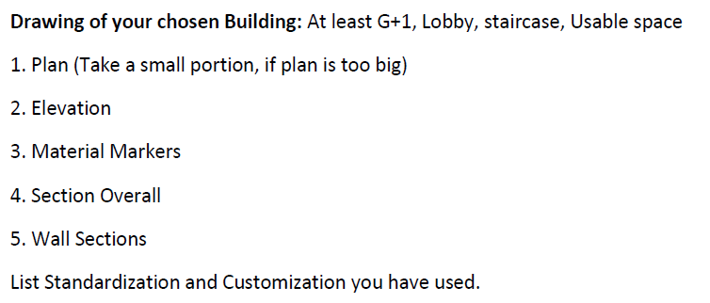
EXERCISE II

Slide 2
LEVEL PLANS

Slide 3
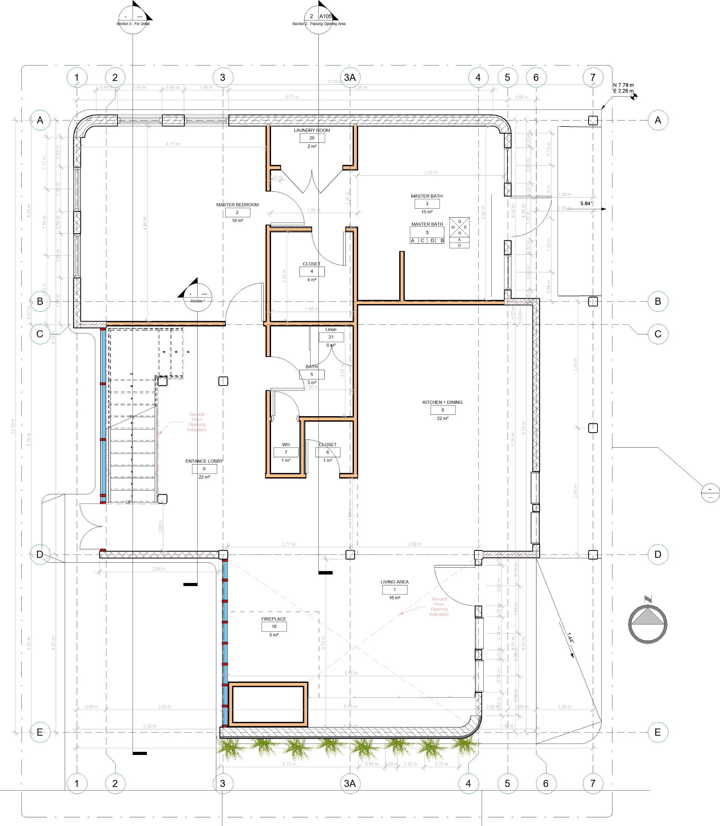
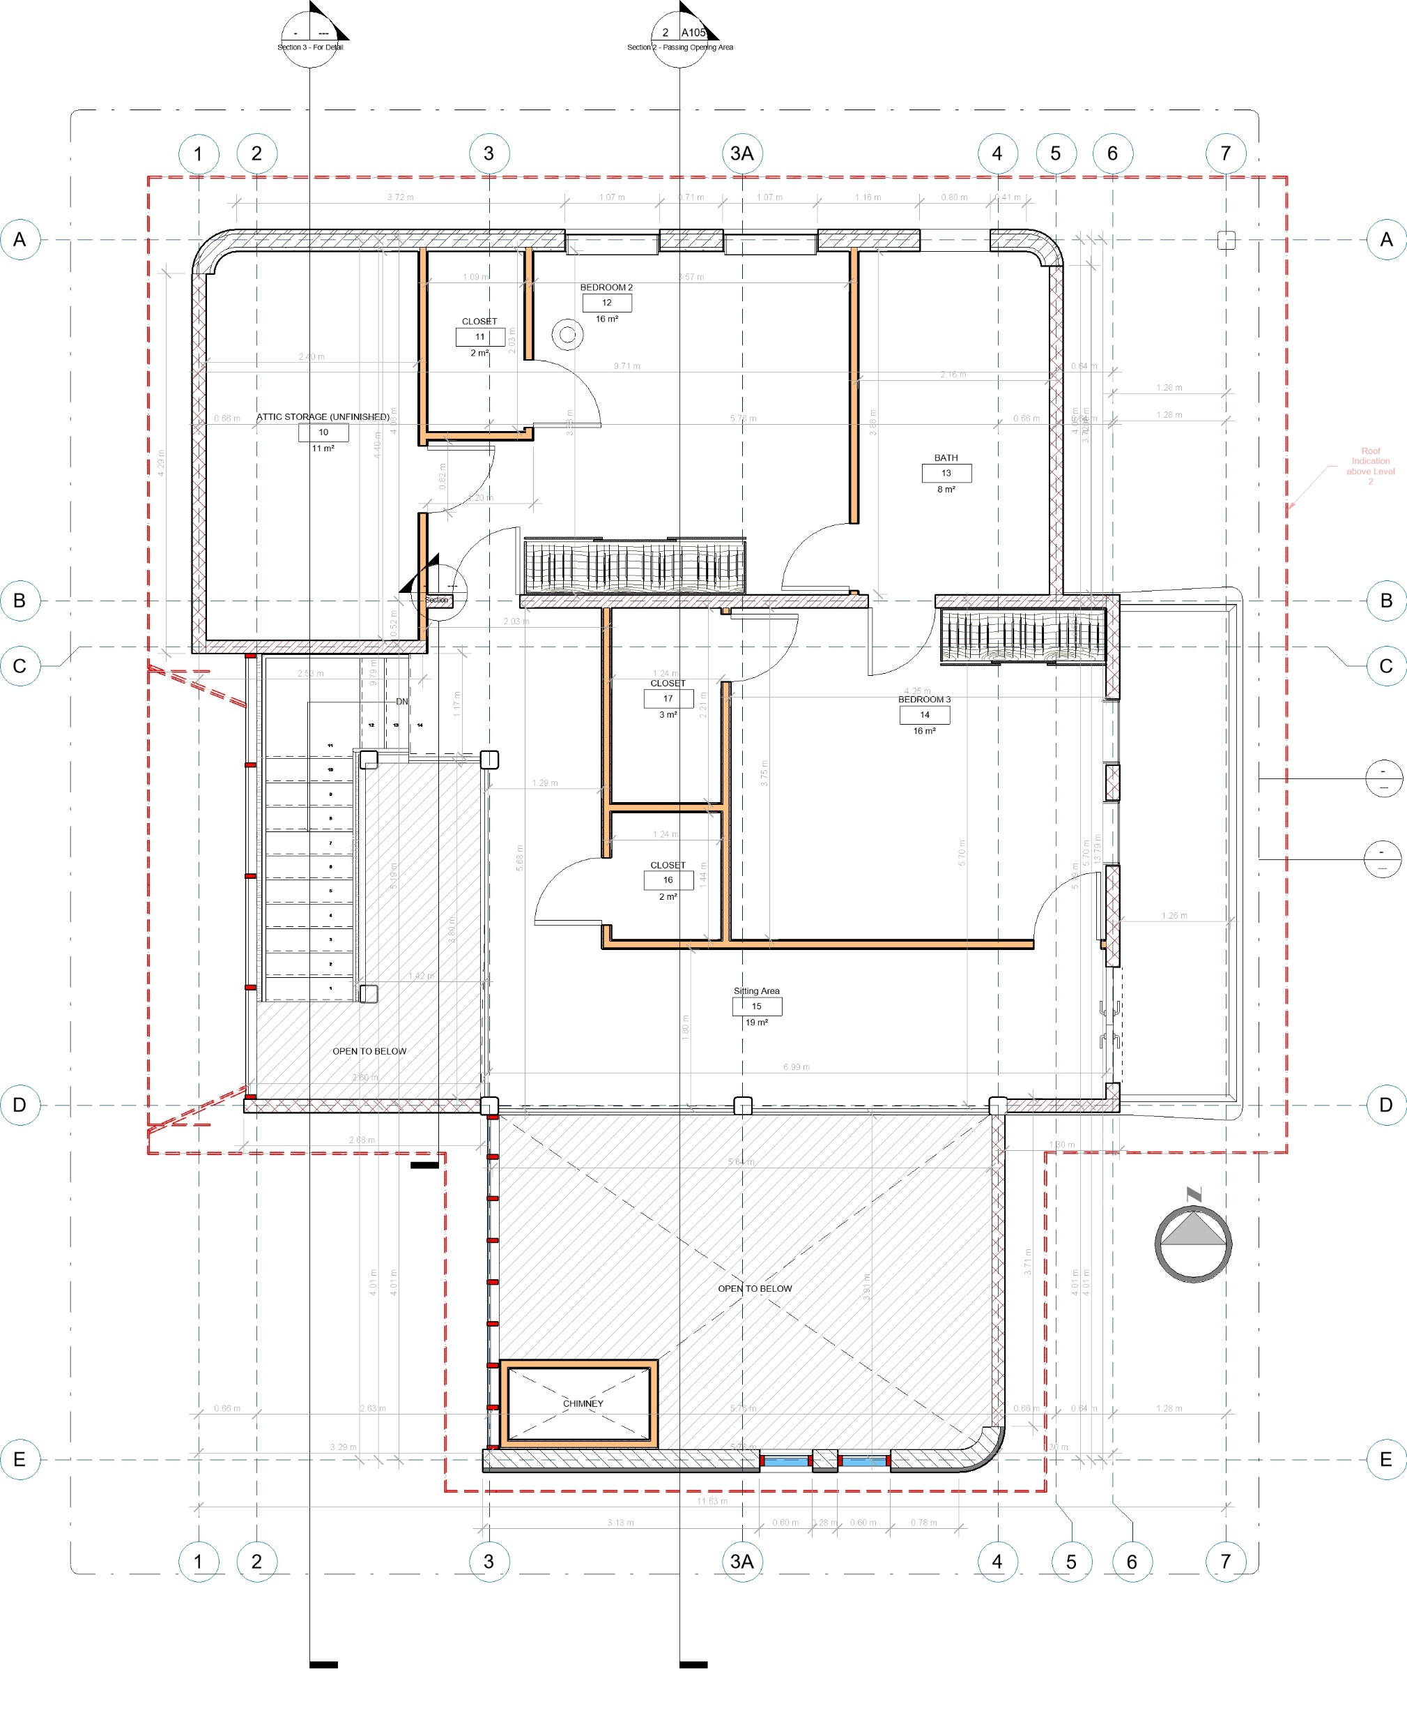
FIRST LEVEL
SECOND LEVEL

Slide 4
ELEVATIONS

Slide 5


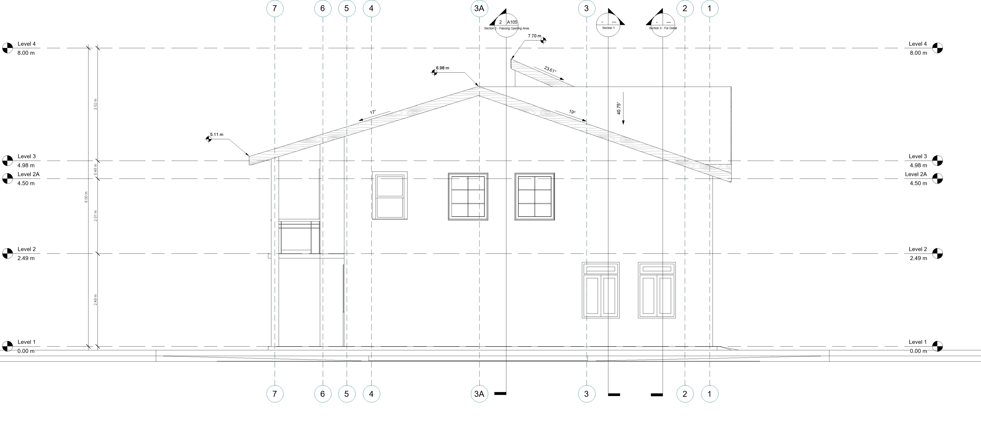

ASPHALT SHINGLE
CLAPBOARD SIDING FINISH

Slide 6
SECTIONS

Slide 7
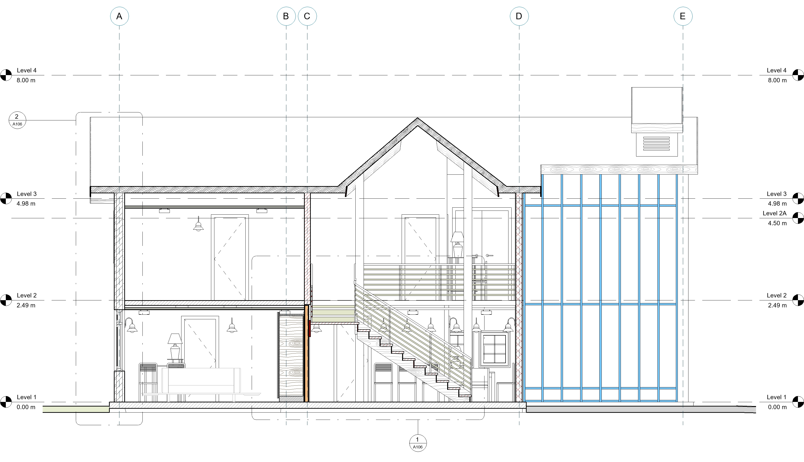

Slide 8
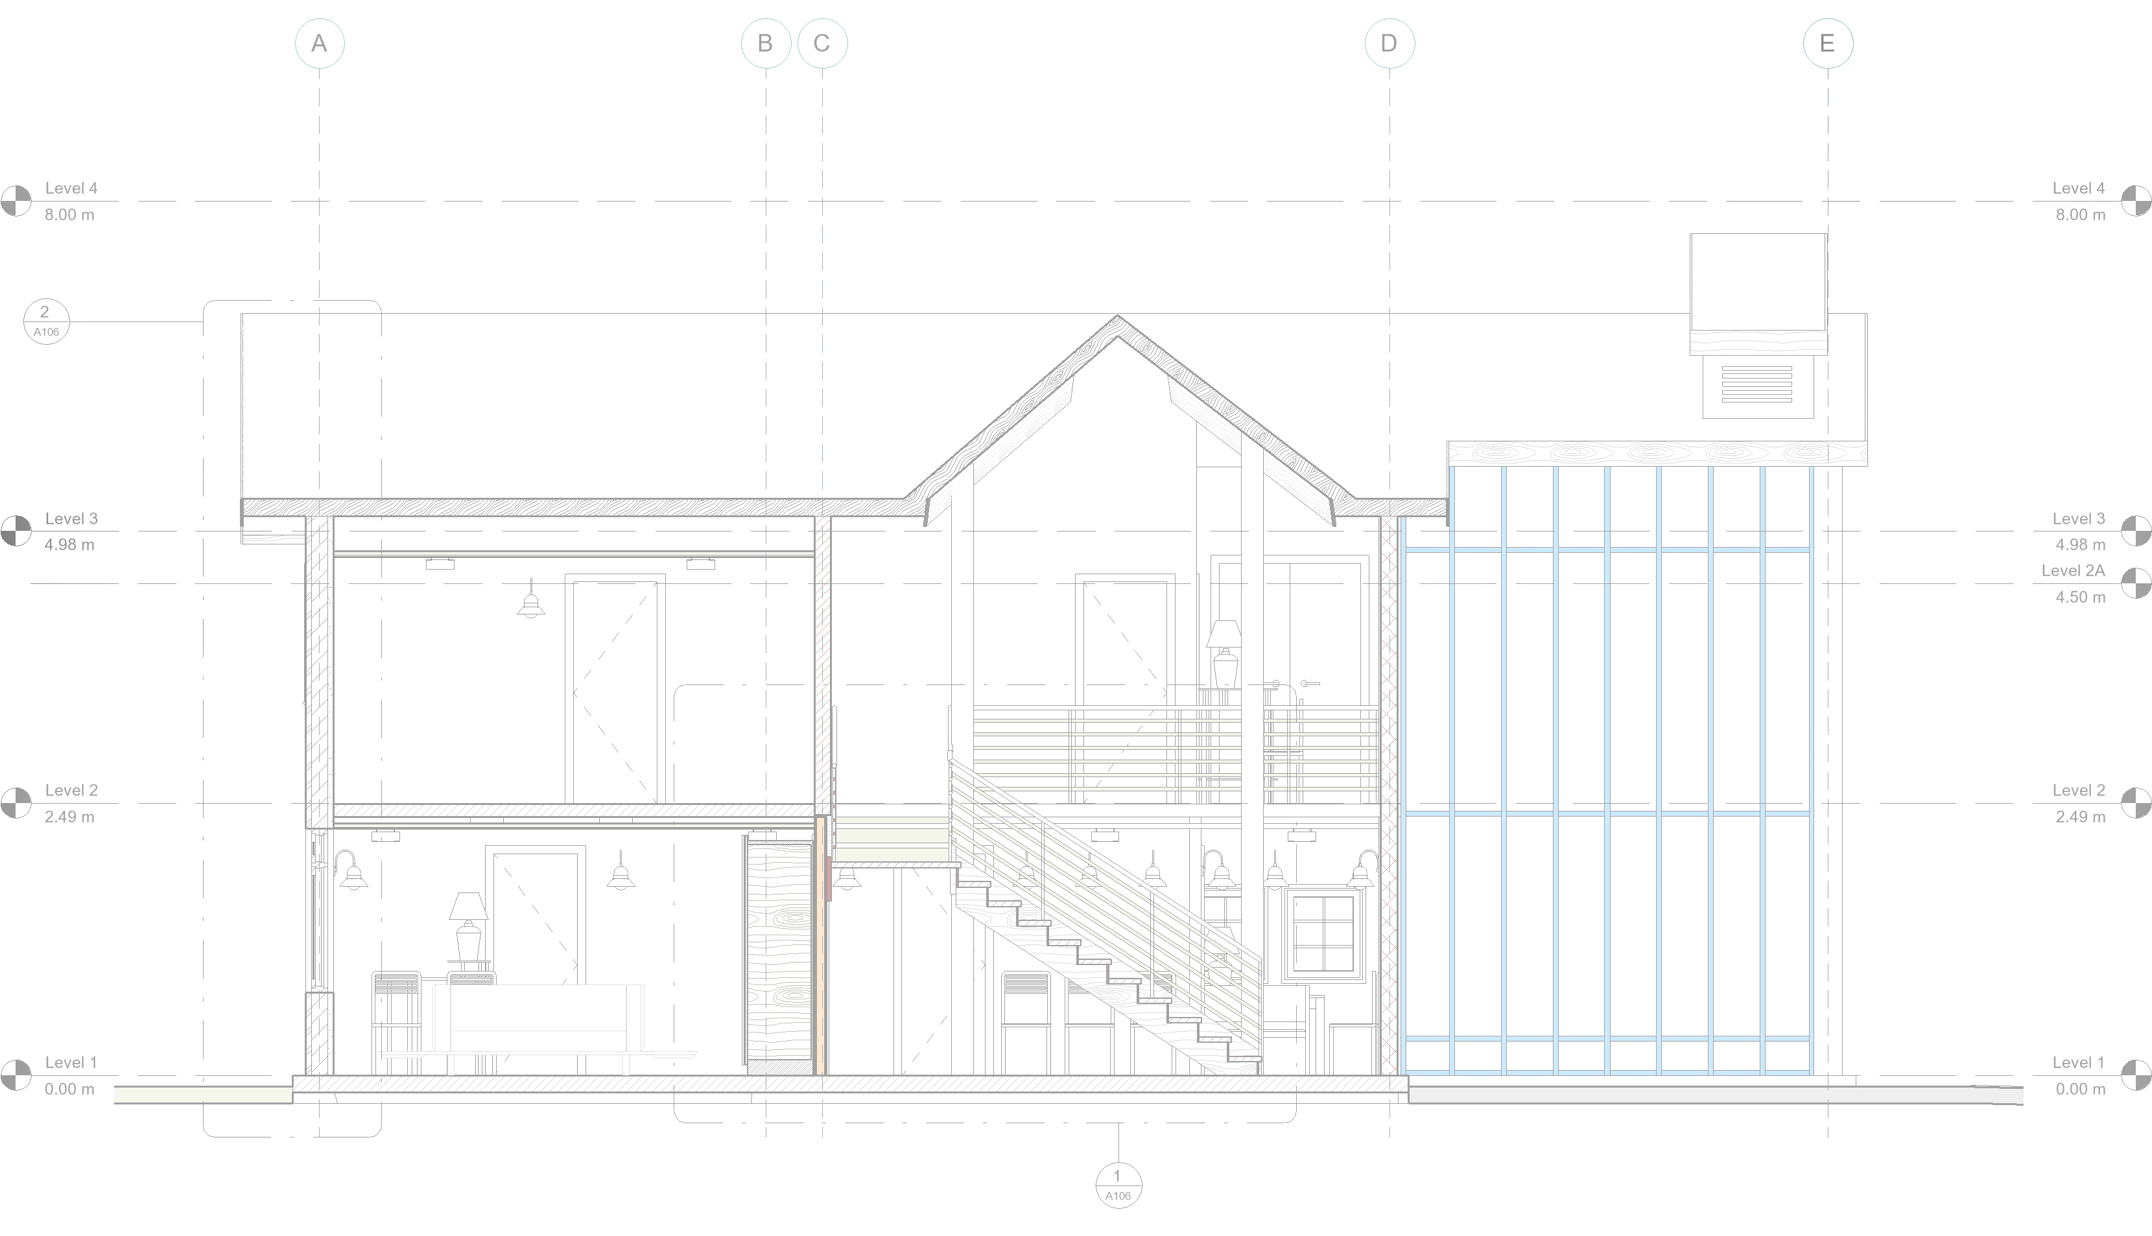
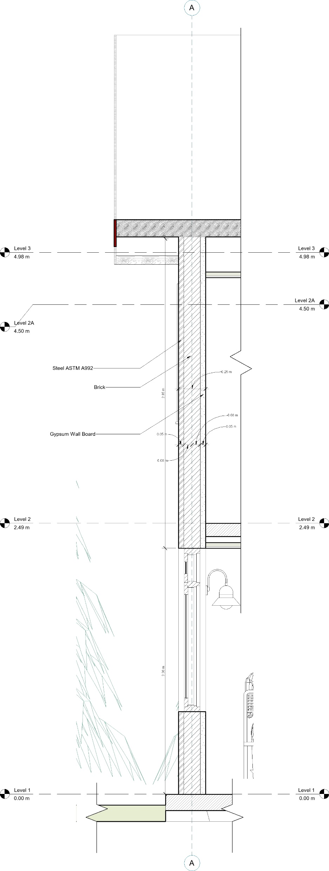

Slide 9
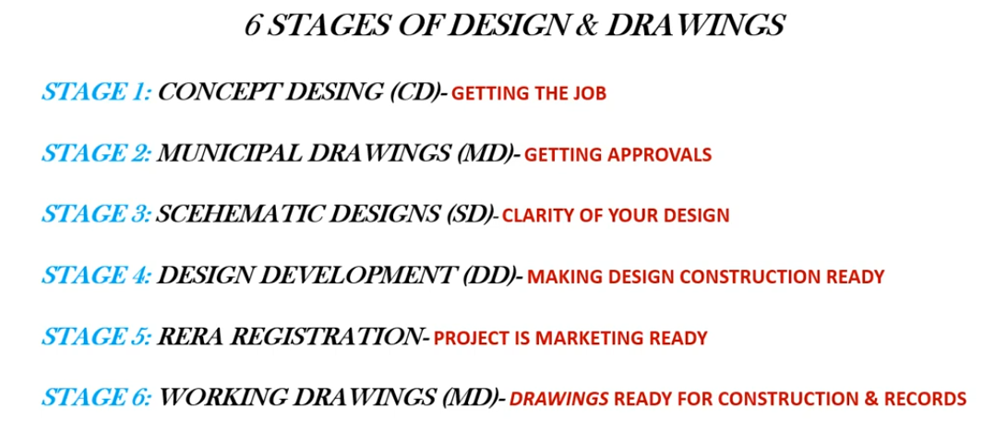

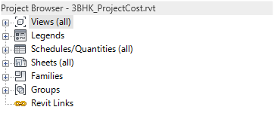
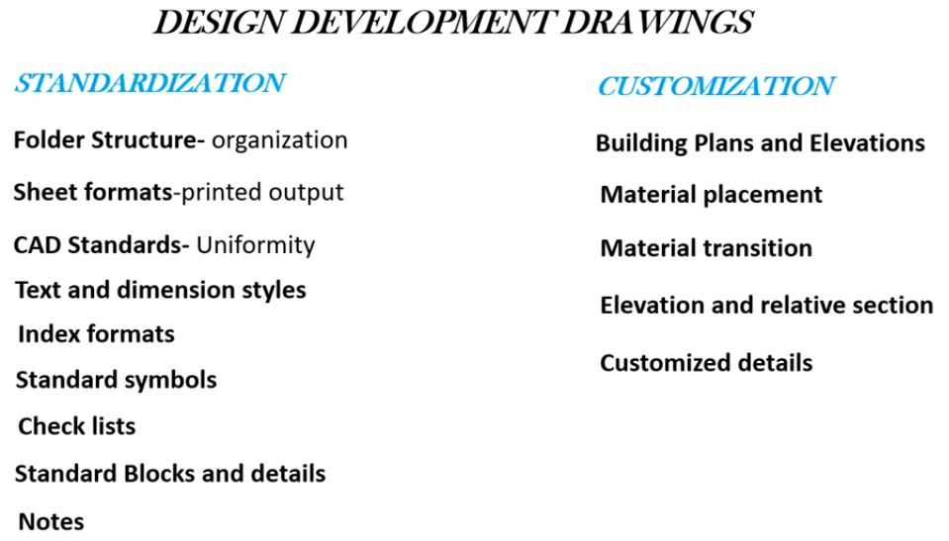
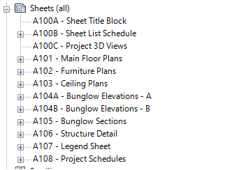
PROJECT BROWSER ORGANIZATION

Slide 10

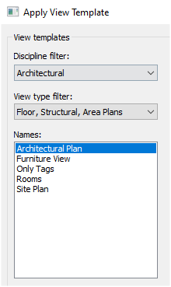
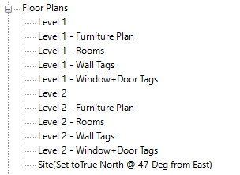
VIEW TEMPLATE SETTINGS
SHEET
TITLEBLOCK
TEMPLATE
LAYOUT ORGANIZATION

