Slide 1
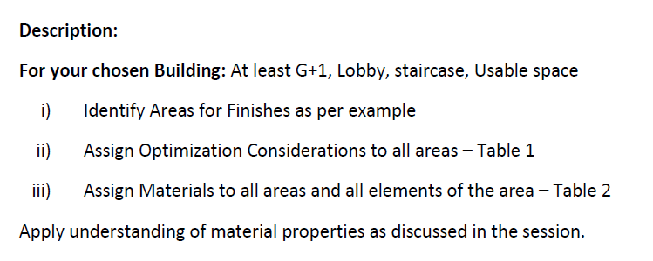
EXERCISE III

Slide 2
AREA IDENTIFICTION

Slide 3
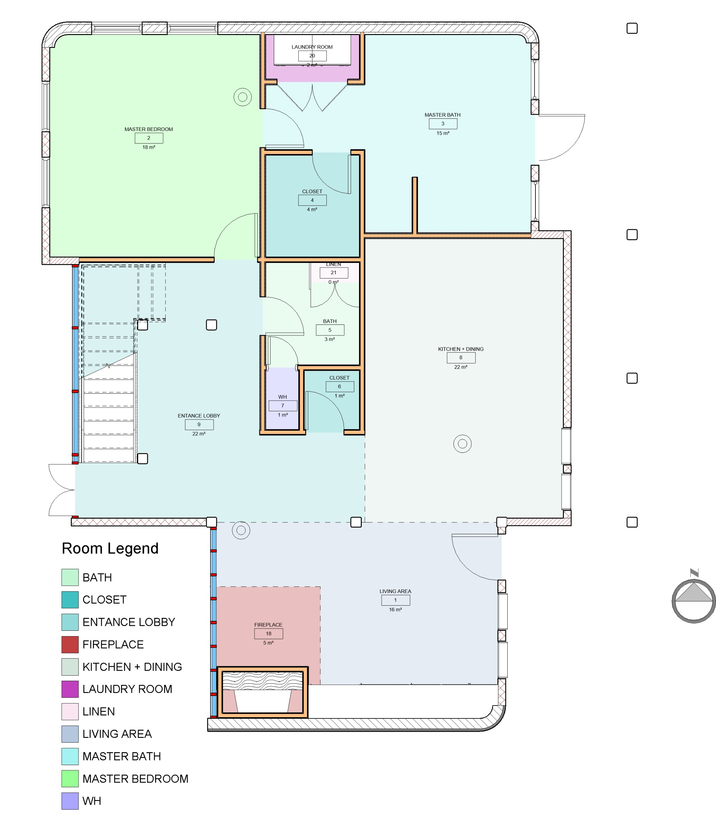
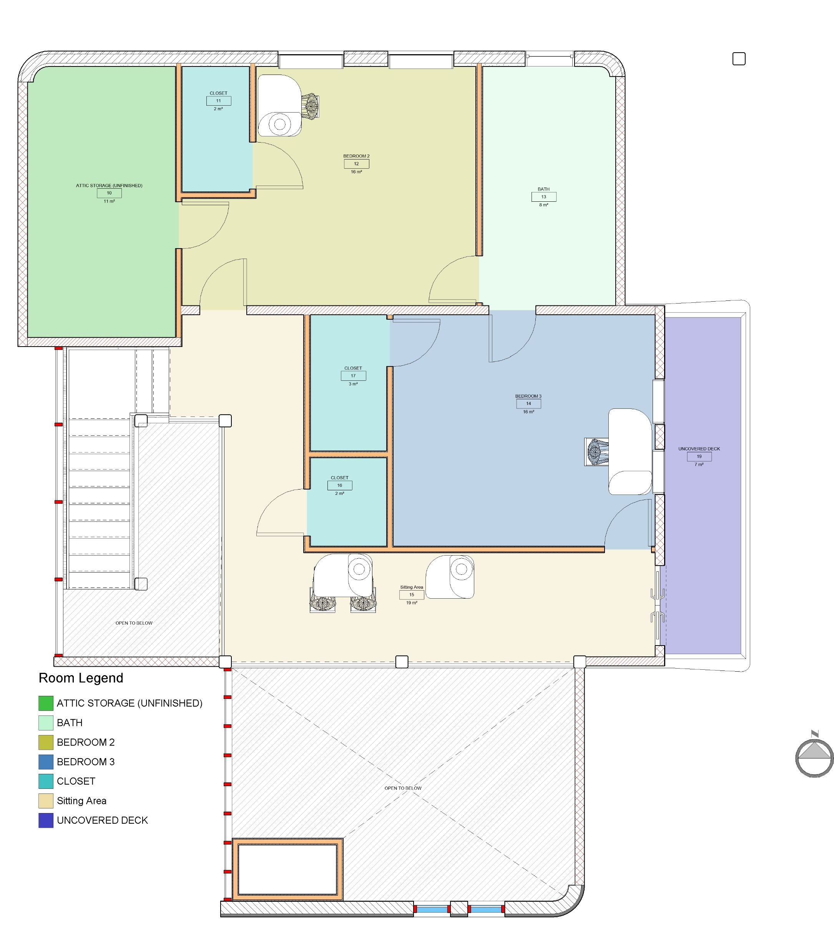
FIRST LEVEL
SECOND LEVEL

Slide 4
FINISHING OPTIMIZATION - CONSIDERATIONS
(3BHK FARMHOUSE)
LOCATION | VISUAL | DURABILITY | COST
ENTRANCE LOBBY
FIREPLACE
LAUNDRY ROOM
LIVING AREA
LINEN CLOSET
BEDROOM - MASTER
BEDROOM

